Slide 1
Anesthesia for bowel obstruction
Meron A.
June, 2024

Slide 2
Contents
Introduction
Etiologies
Pathophysiology
Clinical presentations
Management
Anesthetic consideration

Slide 3
Bowel obstruction
A partial or complete blockage of bowel that prevents forward movement of intestinal contents
Impaired GI transit is results from various intrinsic and extrinsic conditions
- Intrinsic diseases that can cause intestinal obstruction are usually congenital, inflammatory, neoplastic, or traumatic
- Extrinsic diseases most commonly cause mechanical obstruction of the small intestine.
almost all cases are caused by postoperative adhesions, carcinomatosis, or herniation of the anterior abdominal wall.
Acute intestinal obstruction accounts for ~3% of all hospitalizations and a quarter of all urgent or emergent general surgery admissions.
It is a known fact that it’s by far one of the commonest surgical emergencies.
Notes:
Intrinsic diseases that can cause intestinal obstruction are usually congenital, inflammatory, neoplastic, or traumatic in origin, although intussusception and radiation injury can also be etiologic.
Extrinsic diseases most commonly cause mechanical obstruction of the small intestine.
almost all cases are caused by postoperative adhesions, carcinomatosis, or herniation of the anterior abdominal wall. Carcinomatosis most often originates from the ovary, pancreas, stomach, or colon, although rarely, metastasis from distant organs like the breast and skin can occur. Adhesions are responsible for the majority of cases of early postoperative obstruction that require intervention.

Slide 4
Approximately 60-80% of cases involve the small bowel, and about one-third of these patients show evidence of significant bowel ischemia.
It can be at high or low level in respect to ampulla of vater (bile duct and pancreatic duct joins and drain to small int.)
  High: above ampulla
  Low: below ampulla
Adhesion, herniation and malignancy were found to be a major causes

Slide 5
Less common causes include intestinal intussusception, volvulus, intra-abdominal abscesses, gallstones, and foreign bodies.
Fifty percent or more of large bowel obstructions result from colorectal cancer, with much of the rest caused by diverticulitis, volvulus, and fecal impaction
Notes:
DYNAMIC : where peristalsis is working against a mechanical obstruction.
ADYNAMIC: it may occur in two forms
1st where peristalsis may be absent (paralytic ileus,)occurring secondarily to neuromuscular failure in the mesentery.
2nd where peristalsis may be present in non-propulsive form.(pseudo-obstruction) IN BOTH FORMS MECHANICAL
ELEMENT IS ABSENT.
Adynamic, in which there is no mechanical obstruction; peristalsis is absent or inadequate (e.g. paralytic ileus or pseudo-obstruction)

Slide 6
Etiologies
Regardless of site, onset and types of obstruction, there are causes from
  Outside the wall(extraluminal causes)
    Ex. Adhesions/bands, hernias, abscess,….
  The wall itself(intramural)
    Ex, tumors, congenital stricture, crohn’s disease,….
  Intraluminal(in the lumen)
    Ex. Foreign bodies, GB stones, worms, fecaliths,….

Slide 7
Can be broadly classified as;
  Functional (adynamic) and mechanical obstruction (dynamic)
  Functional obstruction in turn classified as
    Pseudo-obstruction
    Paralytic ileus

Slide 8
1. Psuedo-obstruction:
  Characterised by dilated intestine in the absence of mechanical obstruction
  The disorder is characterized by loss of effective colonic peristalsis and subsequent distention of the colon.
  Patients with pseudoobstruction usually have an insidious clinical course that evolves over months and years for the primary disease and for any coexisting GI diseases
Notes:
Typically such patients have electrolyte disorders, are immobile, or have received narcotic or anticholinergic medications. The disorder can also be observed in surgical patients after a variety of non-GI operations. If left untreated, the massive colonic dilation can result in ischemia of the right colon and cecum,
and perforation.

Slide 9
In general, remissions and exacerbations often occur.
Generally develops in seriously ill patients hospitalized for significant medical problems
A hypothetical suggestion on its etiology stated an excess of sympathetic stimulation and a paucity of parasympathetic input resulting in spastic contraction of the distal colon and functional obstruction.

Slide 10
Majority of cases (70%) with cecal diameter less than 12 cm treated conservatively
  Correction of electrolyte disorders,
  Avoidance of narcotic and anticholinergic agents
  Hydration
  Mobilization and nasogastric suction
Patients for whom conservative therapy fails should be considered for active intervention.
  IV neostigmine @2-2.5mg over 3-5 minutes results in immediate colonic decompression in 80% to 90% of patients.
  Decompressive colonoscopy or placement of a cecostomy are other active interventions that may be needed.

Slide 11
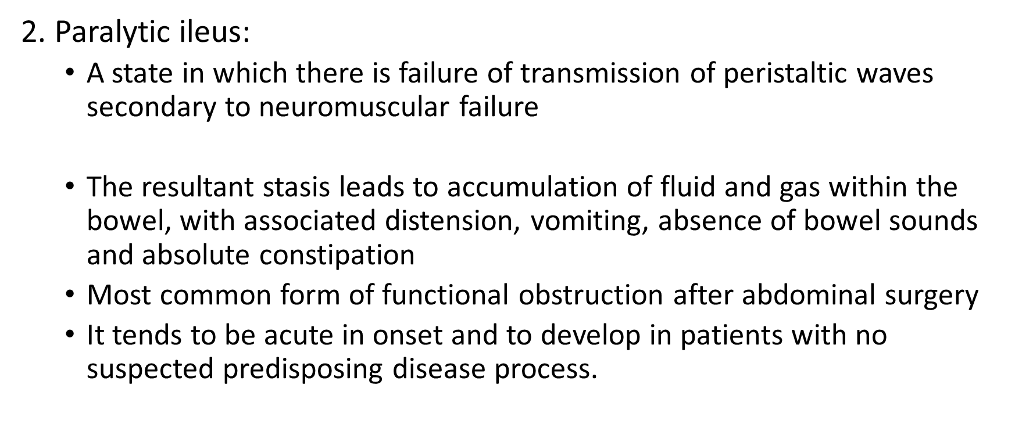
Notes:
Ileus occurs from hypomotility of the gastrointestinal tract in the absence of mechanical bowel obstruction. When a similar condition occurs in the stomach (eg, in diabetes or after pancreatoduodenctomy), it is called gastroparesis or delayed gastric emptying (DGE). Although the exact pathogenesis of ileus remains multifactorial and complex, the clinical picture appears to be transiently impaired propulsion of intestinal contents. The complex interaction between autonomic and central nervous system function, as well as local and regional substances, may alter the intestinal equilibrium, resulting in disorganized electrical activity and paralysis of intestinal segments. This lack of coordinated propulsive action leads to the accumulation of gas and fluids within the bowel.
Functional obstruction, also known as ileus and pseudo-obstruction, is present when dysmotility prevents intestinal contents from being propelled distally and no mechanical blockage exists. Ileus that occurs after intraabdominal surgery is the most commonly identified form of functional bowel obstruction, but there are many other causes (Table 323-3). Although postoperative ileus is most often transient, it is often the most common reason why hospital discharge is delayed. Pseudo-obstruction of the colon, also known as Ogilvie’s syndrome, is a relatively rare disease. Some patients with Ogilvie’s syndrome have colonic dysmotility due to abnormalities of their autonomic nervous system that may be inherited.

Slide 12
Common after most abdominal operations I,e. appendectomy, colorectal surgery, hernioraphy, gynecologic surgeries…
Other abdominal causes of paralytic ileus include blunt trauma, bowel perforation, bile peritonitis, and intra abdominal sepsis.
Non abdominal causes include massive trauma, generalized sepsis, and electrolyte abnormalities such as hypophosphatemia , hyponatremia and hypokalemia
Notes:
After an intraabdominal operation, the electrical disorganization and ineffective coordination of propulsion characterizing an ileus usually resolves after 4–5 days.

Slide 13
Postoperative ileus has the potential to play a significant role in length of hospitalization, morbidity, mortality and cost.
Sympathetic reflexes (induced by surgical stress), bowel manipulation, inflammatory mediator release, and anesthetic/opioid analgesic effects; each of which can inhibit intestinal motility.

Slide 14
To date, there is no specific treatment for postoperative ileus
Nasogastric tubes historically have been inserted to reduce pulmonary complication, hasten bowel function return, increase patient comfort, and shorten hospital stay.
Neostigmine, metoclopramide, laxatives, and non steroidal anti inflammatory agents have theoretical advantages for enhancing GI motility

Slide 15
Mechanical obstruction
  A vexing diagnostic problem that generally requires surgical intervention
  Can be extraluminal, intraluminal and extramural origin
  Can also be simple or strangulated
  Simple: obstruction without vascular compromise(blood flow adequate to obstructed area)
  Strangulating obstruction is obstruction with compromised blood flow; it occurs in nearly 25% of patients with small-bowel obstruction.

Slide 16
Strangulating obstruction can progress to infarction and gangrene in as little as 6 hours.
Venous obstruction occurs first, followed by arterial occlusion, resulting in rapid ischemia of the bowel wall.
The ischemic bowel becomes edematous and infarcts, leading to gangrene and perforation. In large bowel obstruction, strangulation is rare (except with volvulus)

Slide 17
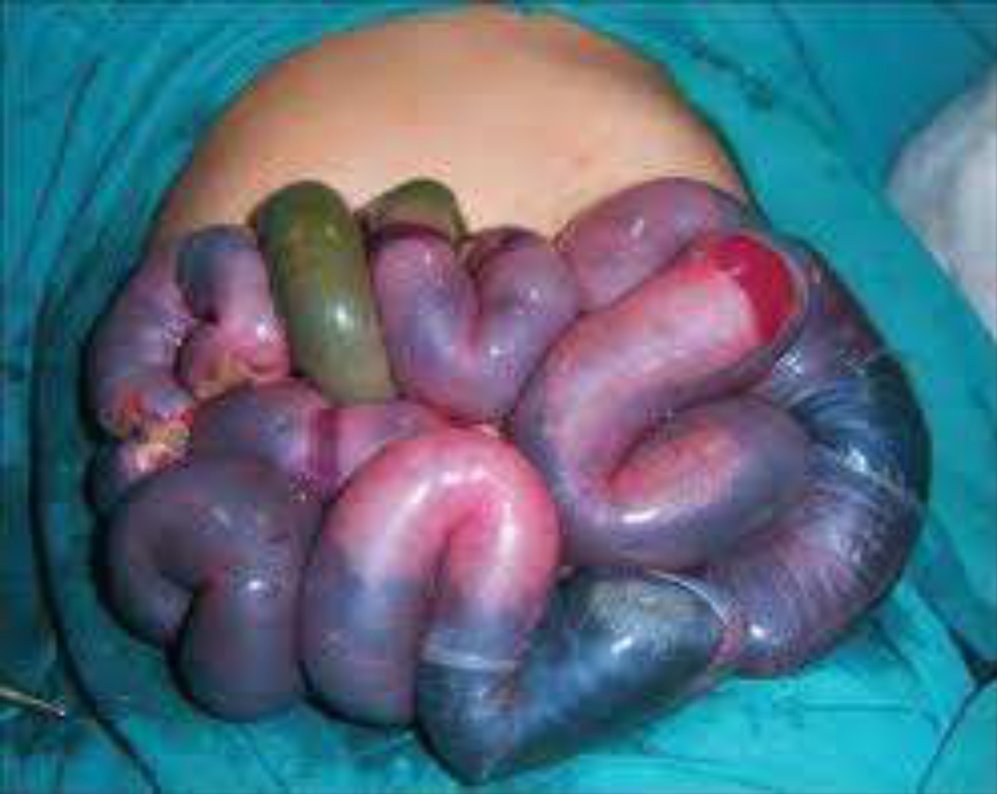
Fig. Strangulated bowel

Slide 18
Pathophysiology
The fundamental concerns are its effect on whole body fluid/electrolyte balances and the mechanical effect that increased pressure has on intestinal perfusion.
Initially increased intestinal contractility both proximally and distal to the obstruction, is a characteristic response.
Subsequently, intestinal peristalsis slows as the intestine or stomach proximal to the point of obstruction dilates as it fills with gastrointestinal secretions and swallowed air.
Notes:
In simple mechanical obstruction, blockage occurs without vascular compromise. Ingested fluid and food, digestive secretions, and gas accumulate above the obstruction. The proximal bowel distends, and the distal segment collapses. The normal secretory and absorptive functions of the mucosa are depressed, and the bowel wall becomes edematous and congested. Severe intestinal distention is self-perpetuating and progressive, intensifying the peristaltic and secretory derangements and increasing the risks of dehydration and progression to strangulating obstruction.
Strangulating obstruction is obstruction with compromised blood flow; it occurs in nearly 25% of patients with small-bowel obstruction. It is usually associated with hernia, volvulus, and intussusception. Strangulating obstruction can progress to infarction and gangrene in as little as 6 h. Venous obstruction occurs first, followed by arterial occlusion, resulting in rapid ischemia of the bowel wall. The ischemic bowel becomes edematous and infarcts, leading to gangrene and perforation. In large-bowel obstruction, strangulation is rare (except with volvulus).
Perforation may occur in an ischemic segment (typically small bowel) or when marked dilation occurs. The risk is high if the cecum is dilated to a diameter ≥ 13 cm. Perforation of a tumor or a diverticulum may also occur at the obstruction site.

Slide 19
Ongoing dilation of the intestine increases luminal pressures impedes venous and lymphatic drainage causing edema and hypoxemia distal to blockage with a potential necrosis if obstruction exceeds 12 hours.
This may eventually lead to compromised arterial flow to the bowel, causing ischemia, necrosis, and perforation.
Failure of intestinal contents to pass through the intestinal tract leads to a cessation of flatus and bowel movements.

Slide 20
But below the obstruction, normal peristalsis and absorption in early stage
Later empty and contracted(collapsed) bowel because no digestive material enters it.
Severe hypovolemia occurs due to persistent vomiting, reduced oral intake, orogastric suction, decreased intestinal absorption and increased secretion

Slide 21
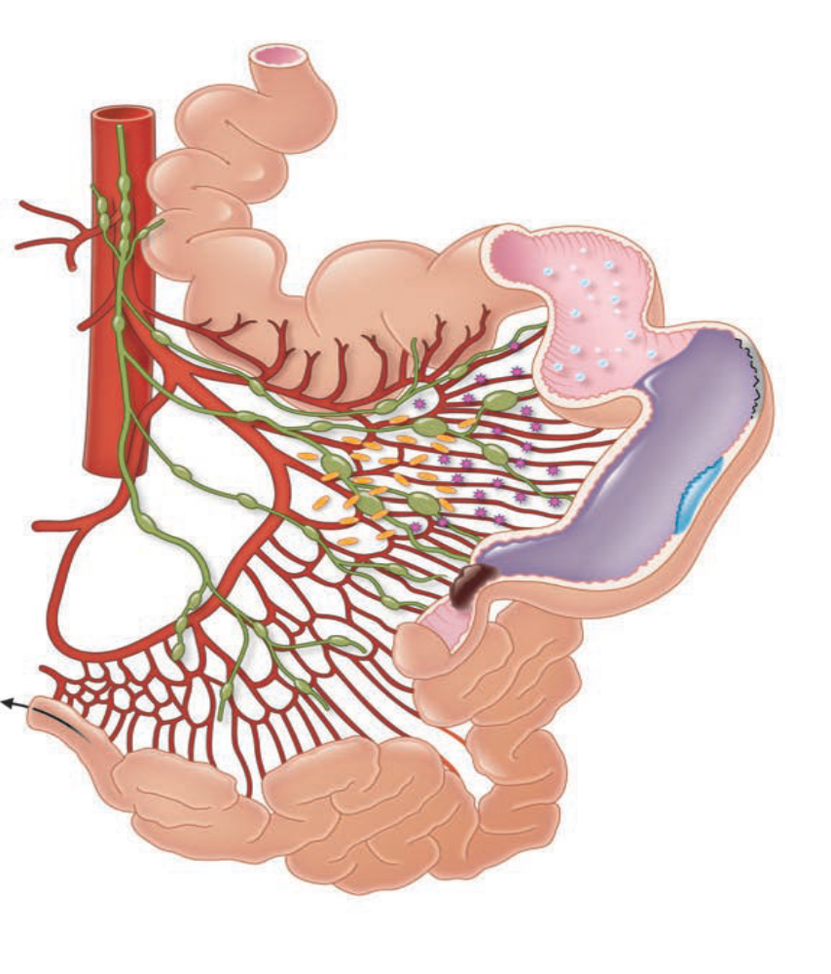
Inflammatory mediators
Air
Fluid
Epithelial necrosis
Bacteria colonized
Gut wall edema
Point of obstruction
Collapsed bowel distal to obstruction

Slide 22
Clinical features:
The hallmarks of intestinal obstruction include
  Colicky or dull abdominal pain (periumbilical, epigastric/peripheral)
  Nausea and vomiting (early, late or delayed)
  Abdominal distension (little central/whole abdomen and
  Cessation of flatus and bowel movements.
Partially obstructed patients may develop diarrhea while complete obstruction complain obstipation
Shock and oliguria reveals severe volume loss
Notes:
Symptoms and Signs
Obstruction of the small bowel causes symptoms shortly after onset: abdominal cramps centered around the umbilicus or in the epigastrium, vomiting, and—in patients with complete obstruction—obstipation. Patients with partial obstruction may develop diarrhea. Severe, steady pain suggests that strangulation has occurred. In the absence of strangulation, the abdomen is not tender. Hyperactive, high-pitched peristalsis with rushes coinciding with cramps is typical. Sometimes, dilated loops of bowel are palpable. With infarction, the abdomen becomes tender and auscultation reveals a silent abdomen or minimal peristalsis. Shock and oliguria are serious signs that indicate either late simple obstruction or strangulation.
Cecal Volvulus
IMAGE PROVIDED BY PARSWA ANSARI, MD.
Volvulus
IMAGE PROVIDED BY DAVID M. MARTIN, MD.
Obstruction of the large bowel usually causes milder symptoms that develop more gradually than those caused by small-bowel obstruction. Increasing constipation leads to obstipation and abdominal distention. Vomiting may occur (usually several hours after onset of other symptoms) but is not common. Lower abdominal cramps unproductive of feces occur. Physical examination typically shows a distended abdomen with loud borborygmi. There is no tenderness, and the rectum is usually empty. A mass corresponding to the site of an obstructing tumor may be palpable. Systemic symptoms are relatively mild, and fluid and electrolyte deficits are uncommon.
Volvulus often has an abrupt onset. Pain is continuous, sometimes with superimposed waves of colicky pain.
The cardinal signs are colicky abdominal pain, abdominal distention, emesis, and obstipation. More intraluminal fluid accumulates
in patients with distal obstruction, which typically leads to greater distention, more discomfort, and delayed emesis. This emesis is feculent when there is bacterial overgrowth. Patients with more proximal obstruction commonly present with less abdominal distention but more pronounced vomiting.

Slide 23
Dehydration
Hypotension
Tachycardia
Fever
Hypothermia
Notes:
Patients with ileus or pseudo-obstruction may have signs and symptoms similar to those of bowel obstruction. Although abdominal distention is present, colicky abdominal pain is typically absent, and patients may not have nausea or emesis. Ongoing, regular discharge of stool or flatus can sometimes help distinguish patients with ileus from those with complete mechanical bowel obstruction.
Bowel sounds and bowel functional activity are notoriously difficult to interpret. Classically, many patients with early small-bowel obstruction will have high-pitched, “musical” tinkling bowel sounds and peristaltic “rushes” known as borborygmi. Later in the course of disease, the bowel sounds may be absent or hypoactive as peristaltic activity decreases. This is in contrast to the common findings in patients with ileus or pseudo-obstruction where bowel sounds are typically absent or hypoactive from the beginning. Lastly, patients with partial blockage may continue to pass flatus and stool, and those with complete blockage may evacuate bowel contents present downstream beyond their obstruction.
The presence of tenderness should increase the concern about the presence of complications such as ischemia, necrosis, or peritonitis. Severe pain with localization or signs of peritoneal irritation is suspicious for strangulated or closed-loop obstruction.

Slide 24
Investigations
CBC ;better assessed serially
  Hct-severe volume depletion, if anemic suggests malignancy
  WBC count , if concomitant acidosis , sepsis and ischemic necrosis
Electrolytes
  Hypokalemia, hypochloremia, hyponatremia (hypotonic resuscitation)
Renal function tests
  Blood gas analysis
    Metabolic alkalosis and acidosis
Radiologic tests better confirm diagnosis

Slide 25
Management
Directed at correcting physiologic derangements caused by the obstruction, bowel rest, and removing the source of obstruction.
Includes decompression of the stomach, appropriate IV fluids, and attention to conditions in other systems (e.g., infection, renal and cardiovascular problems).
Antibiotics are used to treat intestinal overgrowth of bacteria and translocation across the bowel wall.
The presence of fever and leukocytosis should prompt inclusion of antibiotics in the initial treatment regimen.

Slide 26
Caution should be used when clinical and radiologic evidence suggest complete obstruction, because the use of intestinal stimulation can exacerbate the obstruction and precipitate intestinal ischemia.
Stable patients with intestinal obstruction and a history of abdominal surgery can be conservatively managed initially, using intestinal intubation and decompression, aggressive intravenous rehydration, and antibiotics.

Slide 27
Conservative management is successful in 40 to 70 percent of clinically stable patients, with a higher success rate in those with partial obstruction
With conservative management, resolution generally occurs within 24 to 48 hours. Beyond this time frame, the risk of complication increases. Surgical evaluation is required in this situation

Slide 28
The decision to perform surgery for intestinal obstruction can be difficult; however,
  Peritonitis,
  clinical instability, or not resolving with conservative management
  unexplained leukocytosis or acidosis are concerning for abdominal sepsis,
  Evidence of complete obstruction
  intestinal ischemia, or perforation; these findings mandate immediate surgical exploration.

Slide 29
Anesthetic considerations
Patients with obvious GI obstruction are at risk for regurgitation and aspiration during the induction and maintenance of anesthesia and postoperatively.
The anesthetists/anesthesiologist should be aware of the potential for such difficulty with this group of patients and treat appropriately.

Slide 30
General precautions would include:
  Omission of oral premedication (anti acids,….)
  use of postoperative (and preoperative when indicated) nasogastric suctioning.
  Avoid any respiratory depressants (opoids, sedatives,…)
  Avoid anticholinergics (consider LEST, may aggravate fever and tachycardia)
  Consider rapid sequence induction (10 degree head down position)
  Avoid suxamethonium induced fasciculation (precurarise) or use rocuronium instead
  Remove naso-orogastric suction prior to induction

Slide 31
Choice of anesthesia
  Regional anesthesia? Consider (volume status of the patient)
General anesthesia
  Risk of aspiration is high- increased mortality
  Awake intubation in cooperative patient but avoid anesthesia to vocal cords and larynix (protective reflex against vomiting or regurgitation)
  Ketamine and etomidate are better choices
  Theopental can be used if no systemic hypovolemia occurred

Slide 32
Anesthesia maintenance would be potent inhalational anesthetic with NDMRs for better surgical field.
Titrate inhalational agents carefully to avoid severe hypotension
Avoid nitrous oxide because it increases gas distension
Pain management:
  Consider epidural block in not compromised patients
  Systemic analgesics (opoids, but be careful with remifentanil-exaggerated hypotension)
  NSAIDS (better hastens return of gut function) provided normal renal function

Slide 33
Fluid management
  The choice of a replacement fluid then depends in part on the type of fluid that has been lost.
  Both crystalloids and colloids can be successfully used
  In severely dehydrated patients fluid challenge is a method of safely restoring circulating volume according to physiological need, rather than using fixed hemodynamic end points.
  Colloids are more appropriate than crystalloids for fluid challenge b/c stay longer in the intravascular space
  The response to fluid therapy should be assessed directly by measuring CVP or indirectly via indices of systemic perfusion
  Depending on the patient’s age and the severity of illness or suspected intervention, invasive hemodynamic monitoring may be warranted.

Slide 34
The use of a bladder catheter to closely monitor urine output is the minimum requirement for gauging the adequacy of resuscitation
Blood and blood products are indicated in patients with significant hemorrhage to maintain oxygen-carrying capacity
Active warming should be undertaken with the aim of maintaining normothermia in all circumstances
Significant fluid shifts may affect serum electrolyte concentrations. These should be monitored throughout the perioperative period.
Aggressive replacement of electrolytes is recommended after adequate renal function is confirmed.

Slide 35
Patients not responding to fluid resuscitation should be given vasopressors and inotropes to support their CVS function
Norepinephrine is the first choice for the vasodilated septic patient
Dopamine may be useful in patients with compromised systolic function but causes more tachycardia and may be more arrhythmogenic
Patients who require repeated doses of vasopressors (ephedrine or phenylephrine) despite an adequately restored circulating volume should be commenced on an infusion of vasopressor/inotrope early.

Slide 36
Extubation
  Once a patient is awake and protective reflex returned
  Deep suction of oropharynx
  Keep NG tube insitu post operatively
  Adequate rate and depth of breathing and stable vital signs
  Extubate in lateral and head down position

Slide 37
Post operative concerns
  Assess for correction of fluid and electrolyte
  Monitor CVS and respiratory functions
  Look for presence of paralytic ileus
  Pain control
Respiratory problems
  Pain on surgical site
  Residual anesthetics
  Decreased FRC after upper abdominal surgeries

Slide 38
Anesthesia for emergency laparotomy

Slide 39
Introduction
Laparotomy: Any operation in which the abdomen is opened either for diagnostic purposes or for surgical treatment
Emergency laparotomy’ has become a generic term encompassing several specific non-elective abdominal surgical procedures.
Patients are a heterogeneous group ranging from
  Truly emergent cases, such as patients with life-threatening haemorrhage,
  Urgent cases with intra-abdominal sepsis and peritonitis and
  Expedited cases, such as those with adhesional bowel obstruction, who need a non-elective procedure if a trial of non-operative management is unsuccessful.

Slide 40
Patients form a diverse group in terms of age, and comorbid state
Majority are elderly and with a known or unknown comorbidity in addition to their acute surgical illnesses; their risk level will be highest of all.
  Unfortunately, patients do not have the luxury of time to assess and optimize their preexisting medical conditions properly, complete investigations, and correct any physiological derangements.

Slide 41
Healthy patients can respond to increased oxygen demand induced by acute or chronic state illness by increasing cardiac output; however patients who do not have the physiological reserve to compensate for this increase in stress are at high risk of complications after surgery.
Because of the rapidly progressive course of the surgical presentation, patients often require surgery outside of normal operating hours, and so both the surgeons and the anesthetists responsible for the patient managing

Slide 42
Preoperative assessment
Principle should be similar to elective patients
Identify high risk patient and plan for better care
  The recognition and evaluation of risk plays a crucial role in management planning, and predict the risk that an emergency laparotomy will impose on an individual patient.
  The risks are multifactorial and may include patient age, chronic health issues, acute physiology and preoperative condition, type of operation, time of operation, duration of operation, grade of surgeon and anesthetist, and the intensity of perioperative monitoring and care.

Slide 43
Pathological processes other than the condition to be treated will significantly contribute to the clinical picture and ability of the patient to respond to the acute illness.
Acute or chronic cardiorespiratory diseases , renal and endocrine disorders are important considerations
Inspite of correct surgical diagnosis, the critical condition of these patients usually not recognized or overlooked
Profound dehydration, hypovolemia, hypoxemia and acidosis in these patients are not managed adequately
Thus, perioperative mortality is very high in these patients
Notes:
Every patient with acute abdomen is severely dehydrated unless proven otherwise

Slide 44
Preoperative management usually done by surgeons or emergency physicians in the surgical wards
Anesthetists are rarely involved in preoperative management and frequently meet the critically ill patients in the theatre.
These group of patients sometimes require large amount (>10L) of fluids for resuscitation in first 24 hours
Resuscitation team might be hesitant to infuse such a large volume but aggressive resuscitation significantly reduces mortality in these patients

Slide 45
Preoperative fluid management
  Perioperative hypovolemia is associated with poorer clinical outcomes following elective bowel surgery.
  Hypovolemia will be even more severe in most emergency cases, so intravenous fluid resuscitation is a vital part of care for the sick laparotomy patient.
  A clinically significant hypovolemia can endanger perfusion of vital organs
  Degree of hypovolemia and shock should be sought and treated accordingly
Notes:
Hypovolemia refers to a reduction in extracellular fluid volume, which, when
severe, leads to inadequate tissue perfusion and organ dysfunction. Hypovolemia
can be absolute, with actual loss of volume, or relative, with redistribution of body
fluid or dilatation of the intravascular space resulting in a decrease in the effective
intravascular volume.

Slide 46
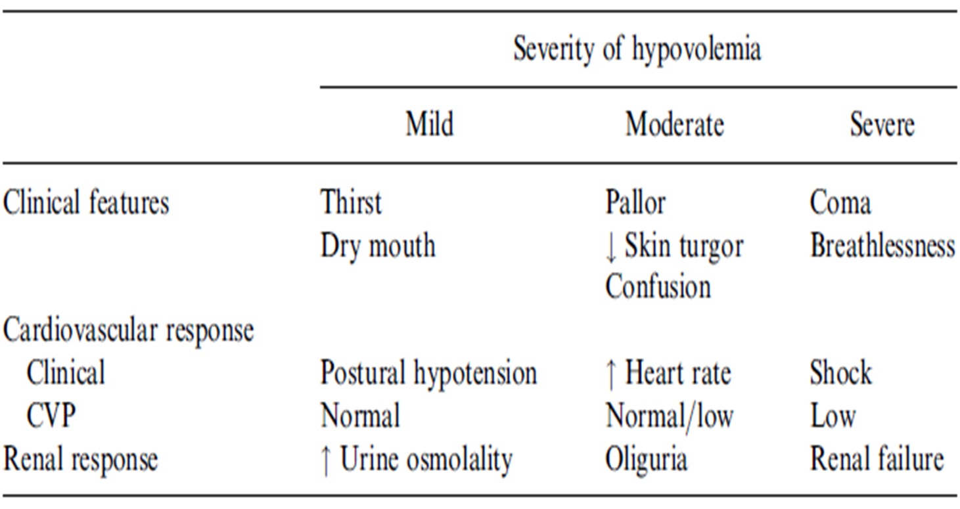

Slide 47
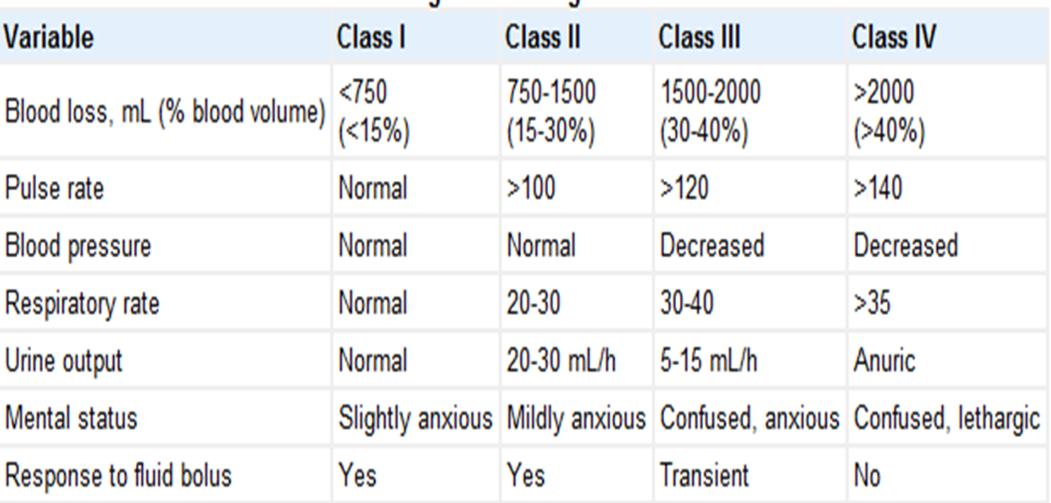
Hypovolemic shock classified

Slide 48
Volume is more important than type of fluids used
  But glucose containing fluids better minimized and avoided if possible (aggravates third space loss)
Management should be targeted at optimizing patient condition prior to surgery to improve survival
Most patients believed to benefit from 2-4 hours of adequate resuscitation prior to surgery
Assess the response to resuscitation either by direct or indirect indices of measurements

Slide 49
Provided that a patient successfully resuscitated, better to commence surgery as early as possible
  Earlier the surgery, better the outcome.
Ideally after successful resuscitation and prior to surgery patients need to be stable with
  PR<100
  RR normal
  SBP>90
  UOP adequate (normalized)
  Normothermia
  Normal capillary refill

Slide 50
Intraoperative
  Abdominal decompression with orogastric tube prior to any medication
  RSI with cricoid pressure after preoxygenation
  Choice of induction agent depends on patients condition
  However ketamine is commonly used in most scenario with uncorrected volume status
  A well resuscitated and with good volume status can be induced with thiopental or etomidate

Slide 51
Maintenance anesthesia should be individualized
  May consider ketamine infusion than inhalational anesthetic in hypotensive patients
  If hypotension occurs after induction, treat with rapid fluid infusion and bolus vasopressors (ephedrine or adrenaline) but we have to make sure the patient is taking adequate amount of fluid
  Vital signs should be monitored and recorded carefully by using standard as well as invasive monitors in individualized basis
  Adequacy of UOP via Foley catheter should be measured

Slide 52
CVP is the most commonly used surrogate marker of volume status,
Intraoperative fluid management is a crucial element determining perioperative outcomes
  The aim of fluid resuscitation is to increase intravascular volume and to improve cardiac output and organ perfusion
  Both crystalloids and colloids can be used to replace extracellular fluid deficit.

Slide 53
Rapid infusion of large amount of normal saline may cause hyperchloremia thus better combined with Hartman's solution (may be better alone)
In patients with significant preoperative bleeding and anticipated intraoperative blood loss, blood and blood products may be considered
Central neuraxial block should be cautiously used in compromised patients.
  The risk of infections, excessive hypotension, and potential complications due to coagulopathy.

Slide 54
May use fentanyl or morphine for intra-operative analgesia
Postoperative
  Wherever possible, compromised patients who have undergone major surgery should be nursed in ICU for a period of stabilization.
  Patients who are cold, cardiovascularly unstable, acidotic, or hypoxic should be kept intubated and ventilated until stable.
  If inotropes/vasopressors have been needed in the operating room, they should be continued postoperatively.

Slide 55
Basic physiological parameters; BP, HR, UOP, temperature, Sao2, ….should be carefully monitored in next 24 hours
Signs such as tachypnea, tachycardia, hypothermia, hypoxia, change in mental status should necessarily alert medical staff
Frequent review of postoperative fluid balance guided by vital signs and CVP measurement.
Fluid requirement may remain high in post operative period attributed towards continued third space loss and remaining deficit from preoperative loss

Slide 56
Therefore, fluid requirement may be above calculated daily maintenance
Urine output should be maintained above 0.5 ml/kg/hr perioperatively
Administer supplemental oxygen 3-4 L/min for a minimum of 72 hr postoperatively.

Slide 57
Peritonitis

Slide 58
Introduction
Peritonitis is an inflammation of the peritoneum (visceral or parietal)
It may be localized or diffuse, acute or chronic, and infectious or aseptic.
Acute peritonitisis most often but not always infectious in origin, resulting from perforation of a hollow viscus.
When no bacterial source is identified, infectious peritonitis is called primary or spontaneous.

Slide 59
Classifications
Type | Description | Causes
Primary or SBP | Inflammation of peritonium in patients with preexisting ascites | Bacterial infection of ascitic fluid
Secondary peritonitis | An inflammation due to mechanical break in GIT or GUT that exposes GIT to resident flora. | Bacterial infection due to perforated viscus; apendix, duodenal ulcer, diverticula,….
Tertiary peritonitis | Recurrent or persistent intra-abdominal infection after surgical control of sec. peritonitis | Failed surgical control or inadequate antibiotics to sec. peritonitis
Chemical peritonitis | Inflammation of peritonial cavity without bacterial inoculation or commonly by irritants | Irritants such as bile, blood, barium, surgical instruments, stomach acids, pancreatic juices…

Slide 60
Pathogenesis
A key predisposing factor may be the intestinal bacterial overgrowth found in people with cirrhosis, mainly attributed to delayed intestinal transit time.
Infectious agents gain access to the peritoneal cavity through a perforated viscus, a penetrating wound of the abdominal wall, or external introduction of a foreign object that is or becomes infected, such as a peritoneal dialysis catheter.
Aseptic peritonitis is most commonly caused by the abnormal presence of physiologic fluids like gastric juice, bile, pancreatic enzymes, blood, or urine.
Notes:
Secondary peritonitis most commonly results from perforation of the appendix, colonic diverticuli, or the stomach and duodenum. It may also occur as a complication of bowel infarction or incarceration, cancer, inflammatory bowel disease, and intestinal obstruction or volvulus.
This condition typically occurs in the setting of ascites and cirrhosis, especially in patients with ascites with a low protein concentration (<1 g/L). It is postulated that spontaneous bacterial peritonitis actually develops due to translocation of bacteria from the intestinal lumen to regional lymph nodes with subsequent bacteremia and infection of the ascitic fluid.
Over 90% of the cases of primary or spontaneous bacterial peritonitis occur in patients with ascites or hypoproteinemia (<1 g/L).

Slide 61
It can also be caused by the effects of normally sterile foreign bodies like surgical sponges or instruments.
The chemical irritation caused by stomach acid and activated pancreatic enzymes is extreme and secondary bacterial infection may occur.
Causes:
  Bowel perforation; Trauma, iatrogenic causes (endoscopic perforation, ischemia, anastomotic leak, catheter perforation) ingested foreign body, inflammatory bowel disease, vascular causes, (embolus, ischemia), strangulated hernia, volvulus, intussusception
  Leakage from other organs; bile, urine, pancretic juices,…
  Impaired peritoneal integrity; intraperitoneal chemotherapy, abscess, dialysis, trauma,….

Slide 62
Signs and symptoms:
  Acute, severe abdominal pain with tenderness (diffuse or localised) and fever are cardinal features
  Compliant depends on how patients responds to irritation, I,e. elderly and immuno compromised patients do not complain aggressively
  Diffuse abdominal tenderness and rigidity - diffuse peritonitis
  Absent or decreased bowel sounds
  Tachycardia, hypotension, signs of dehydration

Slide 63
Diagnosis:
  Clinical findings are very helpful
  Difficult in elderly and immuno compromised
  Paracentesis of ascitic fluid (test for protein and for cell count, PMN> 250)
  Leucocytosis
  Serum-ascites albumin gradient
  Bacterial culture (ascitic fluid)
  Radiographic findings (dilated and edematous bowel wall)

Slide 64
Management
Treatment of peritonitis consists of
  Hydration, correction of electrolyte abnormalities, and administration of antibiotics (IV or intraperitonial)
  Glucose or glucose containing fluids b/c patients more likely be hypoglycemic
  Albumin 1-1.5 g/kg (improve oncotic pressure)
  Diuretics (frusemide , spironolactone)
  Correct anemia (transfuse)
  Pain control (opioids ; morphine, pethidine, fentanyl,..)
  Surgical correction of the underlying problem (hemorrhage, abscess, perforation,…)

Slide 65
Investigations
  CBC and Rh
  Electrolyte
  Renal function tests
  Liver function tests
  Serum glucose and albumin
  Coagulation studies
  ECG and echo

Slide 66
Anesthetic plan similar to emergency laparotomy surgeries
Adequate premedication is warranted
Be concerned about pseudo cholinesterase status (prepare plasma in case succinylcholine apnea)
RSI is a technique of choice
Choice of induction agent depends on hemodynamic status of the patient
Adequate perioperative antibiotic coverage

Slide 67
Dose adjustments for protein binding drugs perioperatively
Urine output measurement to measure response to fluid therapy
Mortality rates are less than 10% for uncomplicated peritonitis in otherwise healthy persons.
Mortality rates of 40% or more have been reported in the elderly, those with underlying illnesses, and those in whom peritonitis has been present for longer than 48 hours.

Slide 68
Thanks

